Slide 1
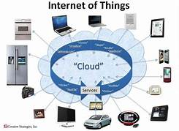
What is the Internet of Things?
In a nutshell, the Internet of Things is the concept of connecting any device (so long as it has an on/off switch) to the Internet and to other connected devices. The IoT is a giant network of connected things and people – all of which collect and share data about the way they are used and about the environment around them.

Slide 2
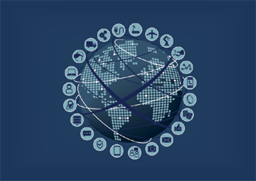
What is the history of IoT?
The Internet of Things (IoT) has not been around for very long. However, there have been visions of machines communicating with one another since the early 1800s. Machines have been providing direct communications since the telegraph (the first landline) was developed in the 1830s and 1840s. Described as “wireless telegraphy,” the first radio voice transmission took place on June 3, 1900, providing another necessary component for developing the Internet of Things. The development of computers began in the 1950s.
The Internet, itself a significant component of the IoT, started out as part of DARPA (Defense Advanced Research Projects Agency) in 1962, and evolved into ARPANET in 1969. In the 1980s, commercial service providers began supporting public use of ARPANET, allowing it to evolve into our modern Internet. Global Positioning Satellites (GPS) became a reality in early 1993, with the Department of Defense providing a stable, highly functional system of 24 satellites. This was quickly followed by privately owned, commercial satellites being placed in orbit. Satellites and landlines provide basic communications for much of the IoT.
One additional and important component in developing a functional IoT was IPV6’s remarkably intelligent decision to increase address space. Steve Leibson, of the Computer History Museum, states, “The address space expansion means that we could assign an IPV6 address to every atom on the surface of the earth, and still have enough addresses left to do another 100+ earths.” Put another way, we are not going to run out of internet addresses anytime soon.

Slide 3
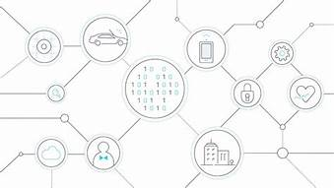
What technologies enable IoT?
1. wireless sensor networks.
2. cloud computing.
3. big data analytics.
4. embedded systems.
Wireless Sensor Networks.
A wireless sensor network comprises of distributed device with sensor which are used to monitor the environmental and physical conditions. A WSN consists of a number of end-nodes and routers and a coordinator. End Nodes have several sensors attached to them in node can also act as routers. Routers are responsible for routing the data packets from end-nodes to the coordinator. The coordinator collects the data from all the nodes.
Cloud Computing
Cloud computing is a trans-formative computing paradigm that involves delivering applications and services over the Internet Cloud computing involves provisioning of computing, networking and storage resources on demand and providing these resources as metered services to the users, in a “pay as you go” model. C loud computing resources can be provisioned on demand by the users, without requiring interacyions with the cloud service Provider. The process of provisioning resources is automated. Cloud computing resources can be accessed over The network using standard access mechanisms that provide platform independent access through the use of heterogeneous client platforms such as the workstations, laptops, tablets and smartphones.
Big Data Analytics
Big Data analytics is the process of collecting, organizing and analyzing large sets of data (called Big Data) to discover patterns and other useful information. Big Data analytics can help organizations to better understand the information contained within the data and will also help identify the data that is most important to the business and future business decisions. Analysts working with Big Data typically want the knowledge that comes from analyzing the data.
Some examples of big data generated by IoT systems are described as follows:
Sensor data generated by IoT system such as weather monitoring stations.
Machine sensor data collected from sensors embedded in industrial and energy systems for monitoring their health and detecting
Failures.
Embedded Systems
As its name suggests, Embedded means something that is attached to another thing. An embedded system can be thought of as a computer hardware system having software embedded in it.

Slide 4
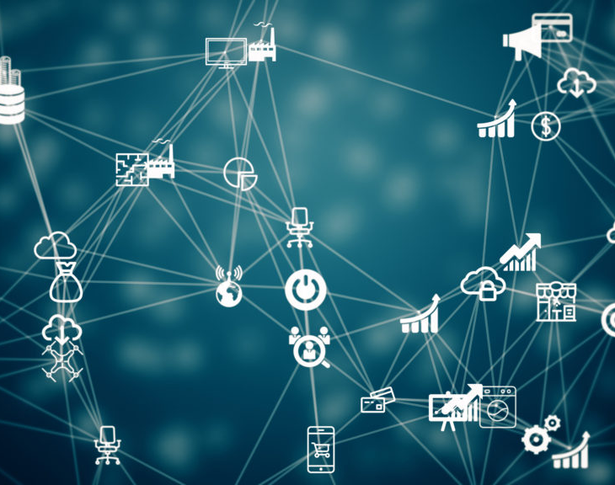
What is its impact?
The IoT is beginning to shape the future of many industries, by generating an unprecedented amount of data. Khalil Dimachkie, technical strategist at Big Radical extensively explores this emerging tech trend

Slide 5
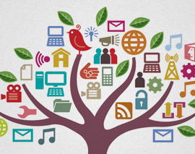
What is its impact going to be in the future?
Over the last 2 to 3 decades, technology has become more and more a part of our daily lives, to the point where it has taken over our lives. Take a moment, stop reading this post and look around you. What do you notice? Do you see tech, gadgets, computers, video monitoring?
Notice how our lives are surrounded by gadgets and tech appliances. The PC at your desk, the cell phone next to your bed, the Wifi router, even your thermostat – all these are examples of how technology has transformed every aspect of our lives; some for the good and others may not be so good.
In this post, we are going to look at some of the latest feats in technology and analyze their positive and negative impact on our lives.
Positive Impact of Technology on Society
Smartphone Revolution
It was just over a decade ago when cell phones were primarily used for calling and sending texts. Today, the uses of cell phones run the gamut. Phones do everything from taking high-resolution pictures to watching pixel-perfect videos, browsing the internet to playing graphic-intensive games to monitoring your movements. It’s astonishing at how this small device can handle demanding tasks in addition to fulfilling basic communication needs.
The advent of smartphones has simplified our lives immensely. People now connect with their loved ones more frequently and easily through video calls and instant messaging services. Tasks, like creating slides, reading emails, and creating documents don’t require a PC anymore.
In a nutshell, smartphone and apps have changed the way we work, communicate and play. In addition, the booming expansion of e-commerce and internet-based companies is directly proportional to the rapid
Negative Impact of Technology on Society
Less-Active Lifestyle
While the smartphone revolution has made our lives easy, it has also made us lazy. Today, the whole world is at our fingertips, and thus we don’t have to work or move around like we did previously to get things done.
Our sedentary lifestyle and lack of physical activities can be partly attributed to the over-dependence on smartphones. This is especially true for the younger generation, who are constantly glued to their cell phones. In the modern era, cell phone addiction is having a negative impact on our lives. Care needs to be taken to deal with this issue in an effective way.

Slide 6
REFERENCES
J.K. Rowling, Harry Potter and the Philosopher’s Stone, 1st ed., Bloomsbury Publishing Inc, London, 1997.
M. Tran, Barack Obama To Be America’s First Black President, (2008).

Slide 7
THANK YOU

